Slide 1
Module 3: Processing scRNA-Seq with Seurat
NC State scRNA Workshop, 2024

Slide 2
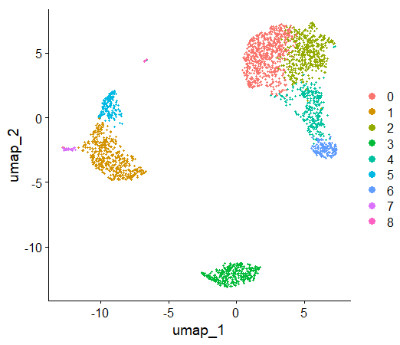
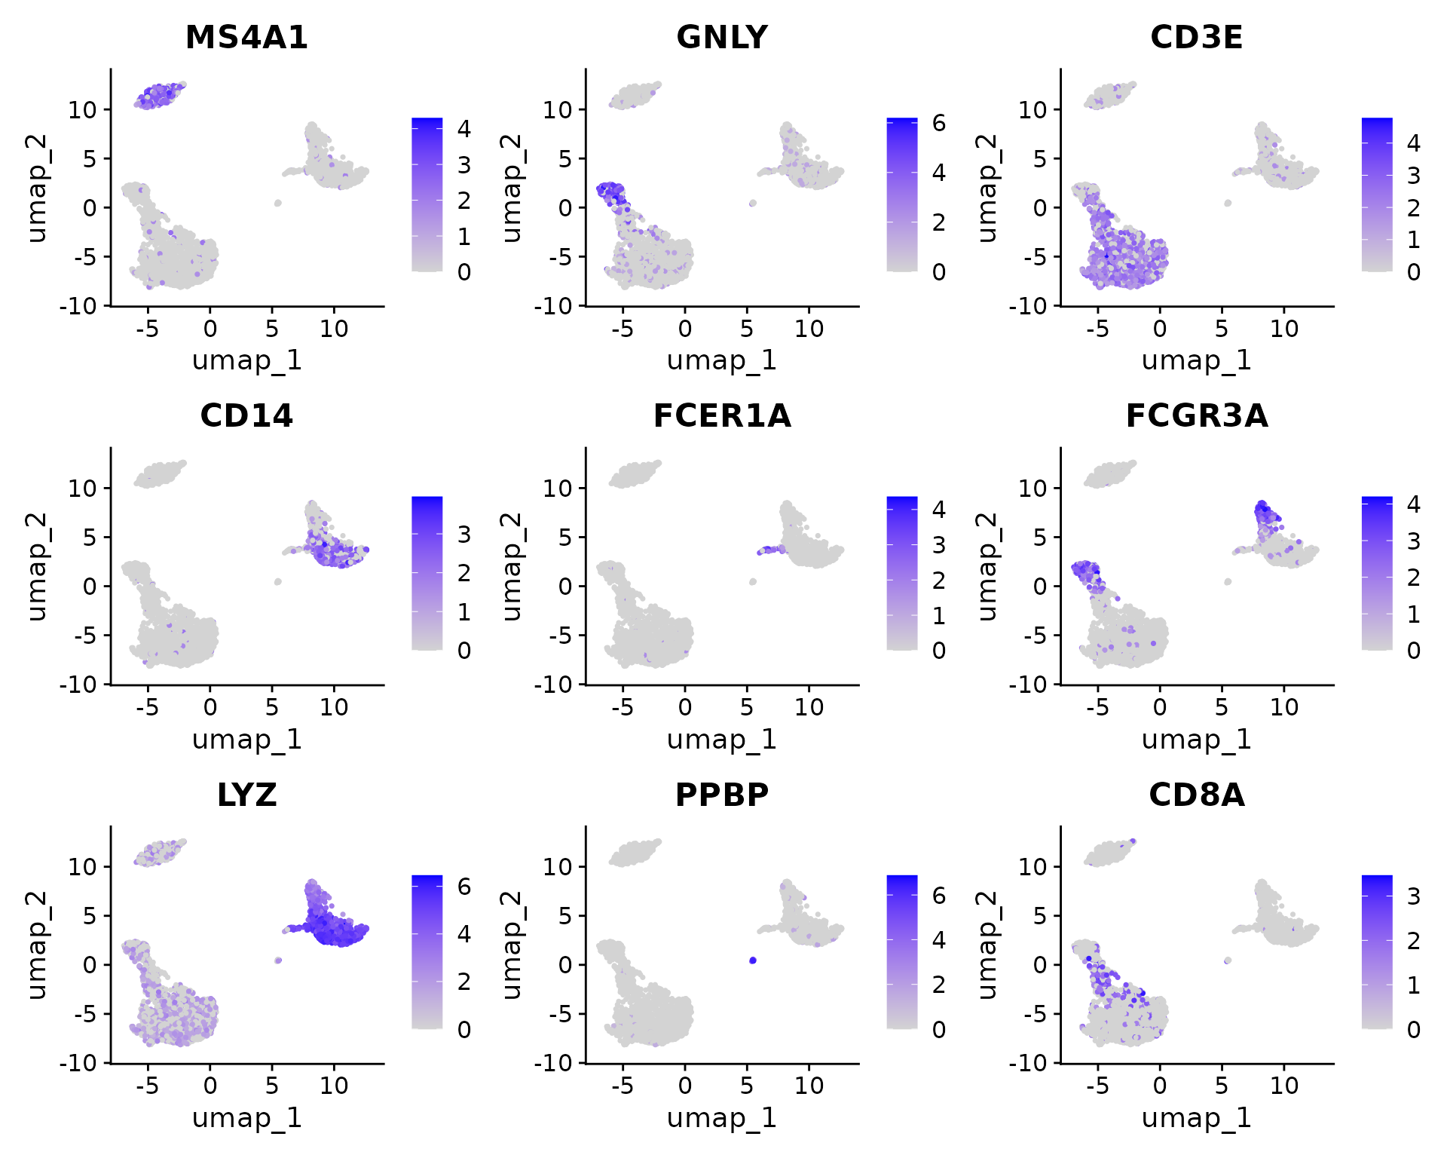
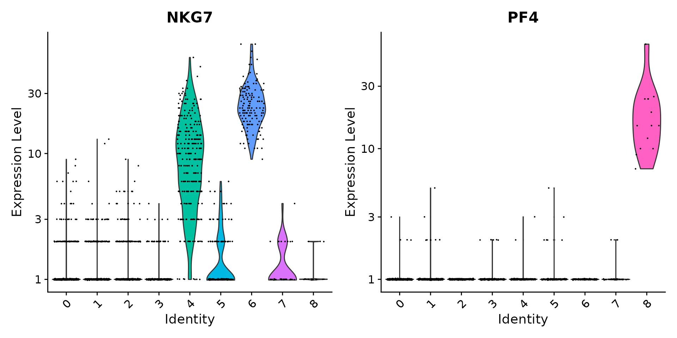
Processing Pipeline Overview
anchor
Add/correct metadata.
Filter low quality data.
Make comparable across genes.
Sequence Alignment Output
Make comparable across cells (and regress confounders).
Reduce dimensions (linear).
Make comparable across runs/ batches/ technologies.
Identify cell clusters.
Basic Results
Reduce dimensions (nonlinear) & Visualize.
anchor

Slide 3
Why so much Dimension Reduction?
Typical Dataset
Simple Reasons:
We visualize the data in 3 dimensions.
Speeds up clustering analysis.
Some analysis techniques only work in low dimensional space (t-SNE).
Genes: 10,000 – 25,000
Cells: 1000 – 100,000
Nuanced Reason:
Curse of Dimensionality: number of datapoints is small (sparse) relative to the intrinsic dimension of the data.
Few datapoints in high dimensional space
All points uniformly distant!
Reducing Dimensions is most of the pipeline:
Subset of genes used for PCA.
Subset of PCA dims used for clustering.
Nonlinear reduction before visualization.
Distance Measures perform poorly.
Clustering Performs Poorly

Slide 4
Note: Integration and Changes Seurat V5 Pipeline
anchor
Seurat V4
Seurat V5
Batch 1
Batch 2
Batch 3
Importation
Importation
Importation
Importation
CreateSeuratObject()
CreateSeuratObject()
CreateSeuratObject()
CreateSeuratObject()
Curation
Curation
Curation
Curation
PercentageFeatureSet()
PercentageFeatureSet()
PercentageFeatureSet()
PercentageFeatureSet()
Filtering
Filtering
Filtering
Filtering
subset()
=
subset()
subset()
subset()
Normalization
Normalization
Normalization
Normalization & Scaling
NormalizeData()
FindVariableFeatures()
NormalizeData()
FindVariableFeatures()
NormalizeData()
FindVariableFeatures()
SCTransform()
Scaling
Scaling
Scaling
ScaleData()
ScaleData()
ScaleData()
Linear Dimensional
Reduction
Linear Dimensional
Reduction
Linear Dimensional
Reduction
Linear Dimensional
Reduction
RunPCA(), ElbowPlot()
RunPCA(), ElbowPlot()
RunPCA(), ElbowPlot()
RunPCA(), ElbowPlot()
Integration
IntegrateLayers()
Note: We are teaching Seurat V4 pipline.
Clustering
Integration
FindNeighbors(),FindClusters()
IntegrateLayers()
Nonlinear Dimension Reduction
Nonlinear Dimension Reduction
Clustering
FindNeighbors(),FindClusters()
RunUMAP(), DimPlot()
RunUMAP(), DimPlot()
anchor
Notes:
https://satijalab.org/seurat/articles/sctransform_vignette

Slide 5
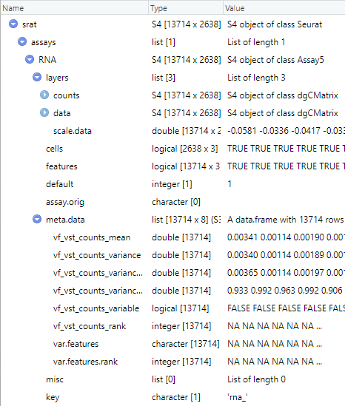
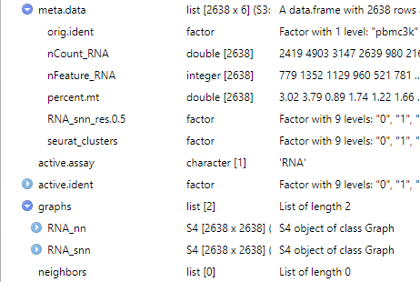
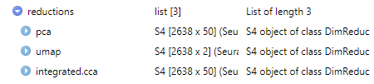
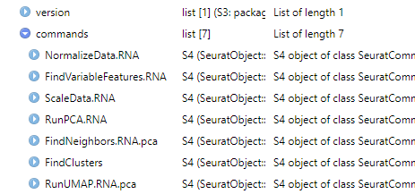
Seurat v5 S4 Class Object
anchor
1
2
1
3
2
1
8
4
4
9
5
3
5
8
8
6
8
6
9
7
7
4
8
5
4
5
6
8
9
8
9
anchor
Notes:
https://www.dreamstime.com/stock-illustration-dna-vector-illustration-human-structure-image49975743

Slide 6
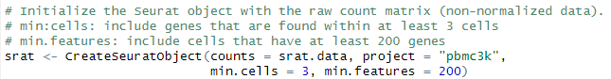
Count Matrix Importation
anchor
An initial minimal filtering on importation
Cell 1
Cell 2
Cell 3
Cell 4
Cell 5
Cell 6
COUNT
COUNT
COUNT
COUNT
COUNT
COUNT
GENE
GENE
GENE
GENE
GENE
GENE
…
…
…
…
…
…
Cell 1
Cell 2
Cell 3
Cell 4
COUNT
COUNT
COUNT
COUNT
GENE
GENE
GENE
GENE
…
…
…
…
anchor
Notes:
https://www.dreamstime.com/stock-illustration-dna-vector-illustration-human-structure-image49975743

Slide 7
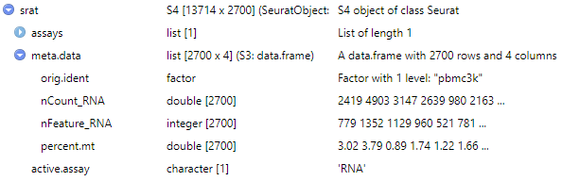
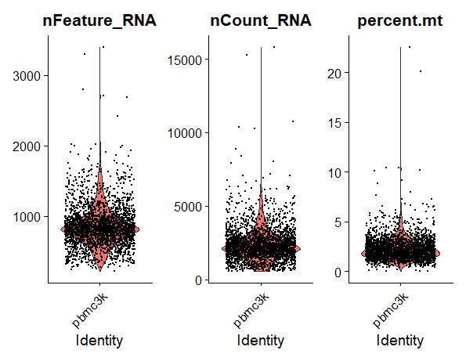
Count Matrix Importation
anchor
Fraction of mitochondrial genes (with nonzero counts) is a metric for cell viability
Some public datasets already perform QC based on MT genes, and all MT genes are removed.
Genes may be labeled at “MT…” or “mt…”, first inspect and confirm what the prefix is.
Accessors
srat@meta.data$percent.mt
srat[["percent.mt"]]
Visualize QC Metrics
anchor
Notes:
https://www.dreamstime.com/stock-illustration-dna-vector-illustration-human-structure-image49975743

Slide 8
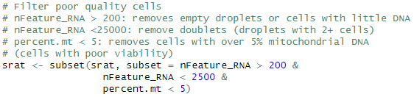
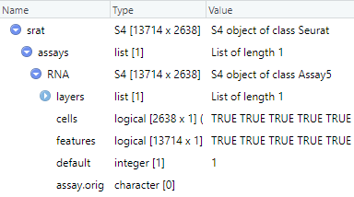
Count Matrix Importation
anchor
Remove poor quality cells with the subset() command.
Uses any metadata in Seurat object.
nFeature_RNA: total genes detected in each cell (low suggest dying cell).
nCount_RNA: total molecules detected in each cell (empty droplets or doublets).
Percent.mt: fraction of mitochondrial genes (celullar health).
Accessors
srat[["RNA"]]@cells
srat@assays$RNA@cells
doublets/dead cells/empty droplets
anchor
Notes:
https://www.dreamstime.com/stock-illustration-dna-vector-illustration-human-structure-image49975743

Slide 9
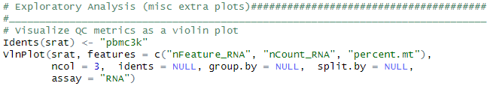
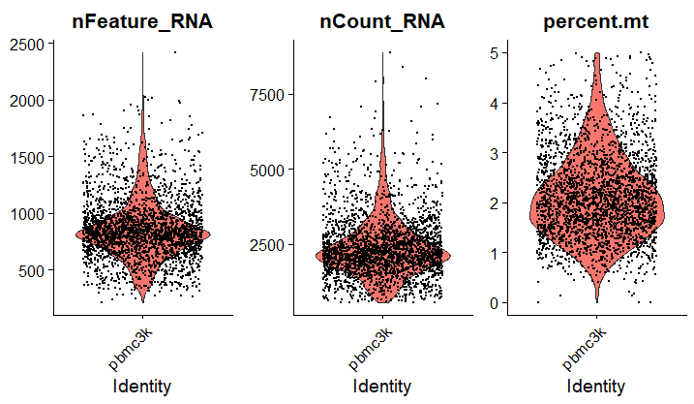
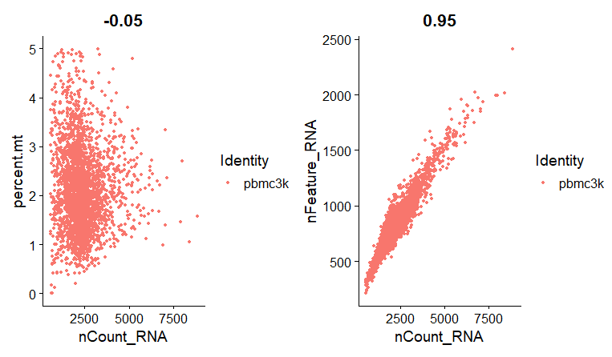
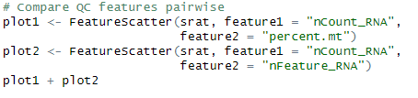
Visualizing Data Import Thresholds
anchor
anchor
Notes:
https://www.dreamstime.com/stock-illustration-dna-vector-illustration-human-structure-image49975743

Slide 10
Now it’s your turn!
Switch to Module 3 Interactive Code, Part 1

Slide 11
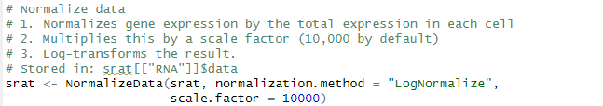
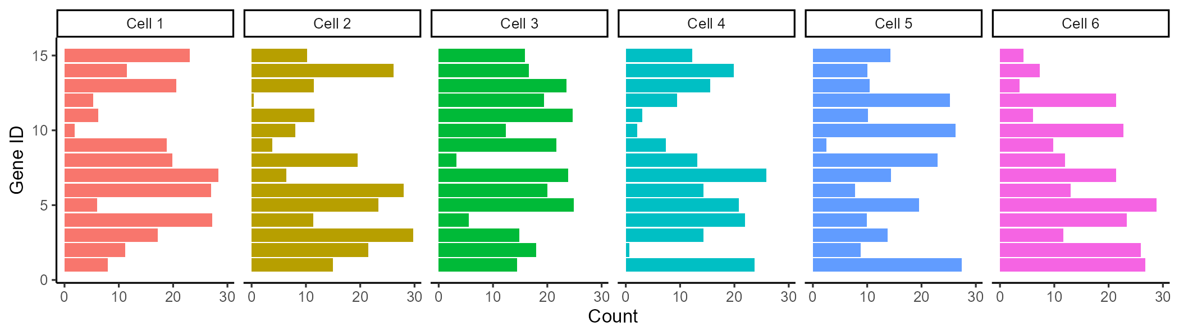
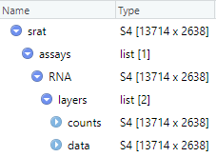
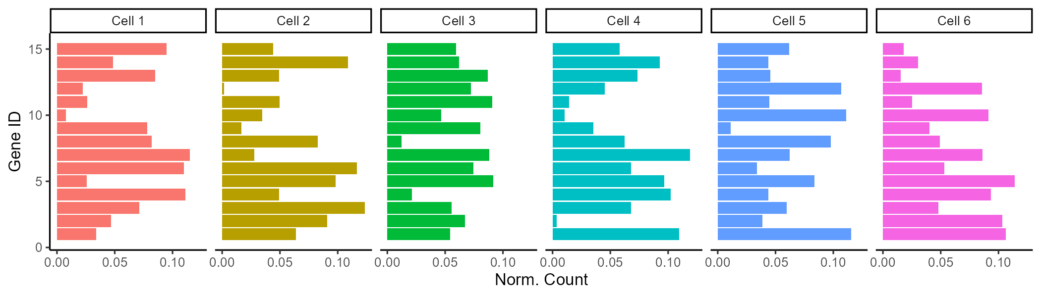
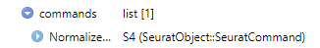
Count Data Normalization
anchor
Normalizing expression ensures expression values across cell are comparable.
1) Higher raw count values could be from cells with larger library size (total reads from that cell).
2,3) Convention to scale values a useful scale (similar to conventions found in bulk RNA seq).
Accessors
srat[["RNA"]]$data
srat@assays$RNA@data
anchor
Notes:
https://www.dreamstime.com/stock-illustration-dna-vector-illustration-human-structure-image49975743

Slide 12
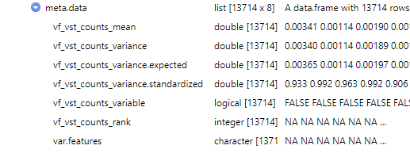
Count Data Normalization: Variable Features
anchor
Identify genes with high variation (used for improved clustering)
Highly variably expressed genes are used as input points for dimension reduction (statically expressed genes only add noise to the transform).
Instead of just calculating gene expression variance across cells (variance is a noisy random variable), normalization and modeling
Accessors
srat[["RNA"]]@meta.data$var.features
srat@assays$RNA@meta.data$var.features
anchor
Notes:
https://www.dreamstime.com/stock-illustration-dna-vector-illustration-human-structure-image49975743

Slide 13
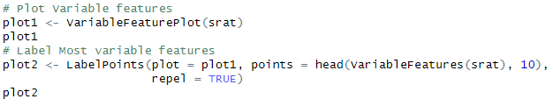
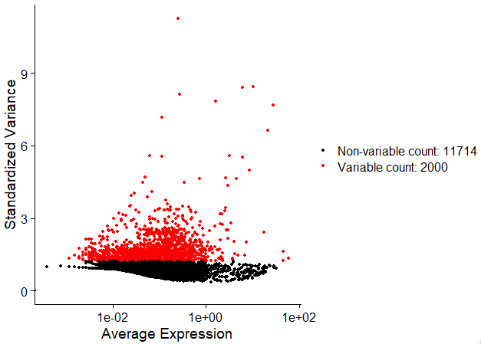
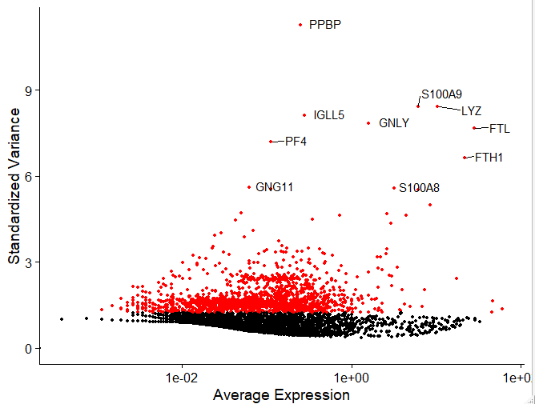
Visualize Highly Variable Features
anchor
anchor
Notes:
https://www.dreamstime.com/stock-illustration-dna-vector-illustration-human-structure-image49975743

Slide 14
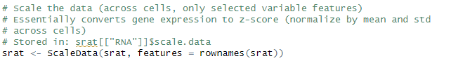
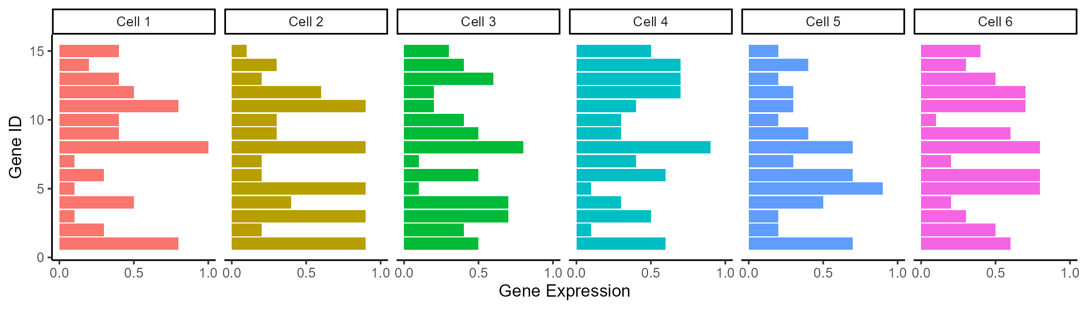
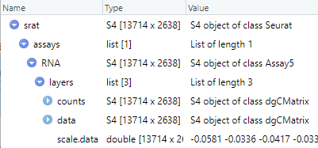
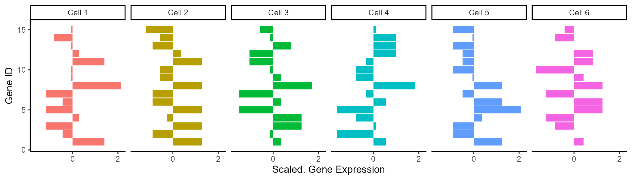
Count Matrix Importation
anchor
Gene expression is scaled (z-scored for each gene) to compare expression across genes.
Centers gene expression by subtracting the average expression for that gene.
Scales expression for each gene by dividing the centered gene expression by their standard deviations.
Z-score = (x-mean(x))/std(x)
# of SD from mean
anchor
Notes:
https://www.dreamstime.com/stock-illustration-dna-vector-illustration-human-structure-image49975743

Slide 15
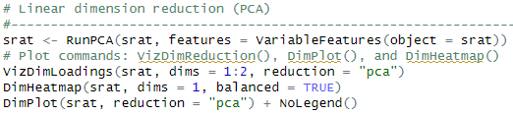
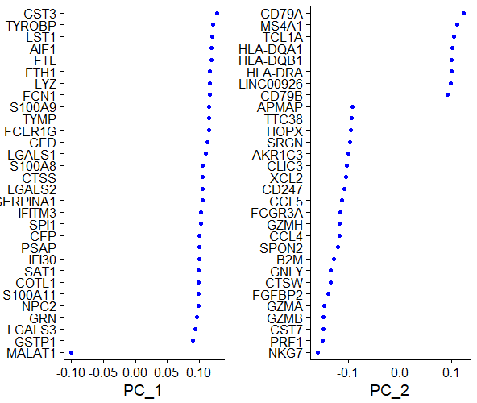
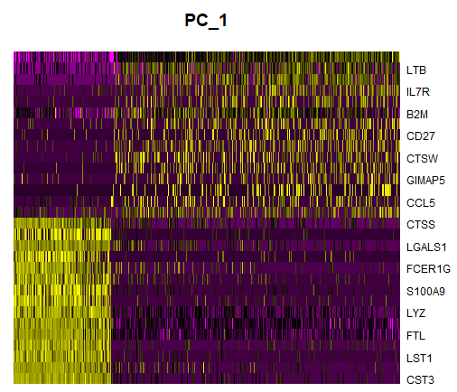
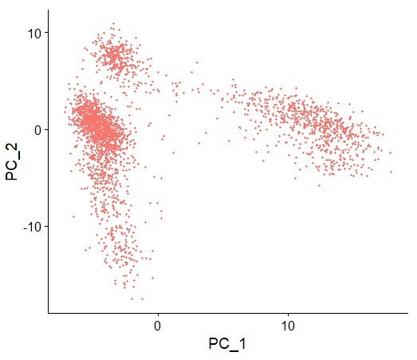
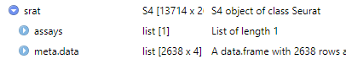
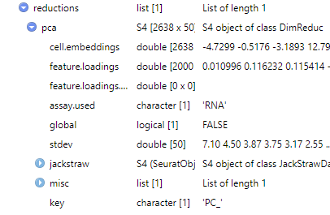
Count Matrix Importation
anchor
1. PCA linearly transforms data onto a new coordinate system such that the principal components (linear combination features) maximizes the variation in the data.
2. Can be used as “anchor points” for nonlinear dimensionality reduction & examine sources of heterogeneity.
anchor
Notes:
https://www.dreamstime.com/stock-illustration-dna-vector-illustration-human-structure-image49975743

Slide 16
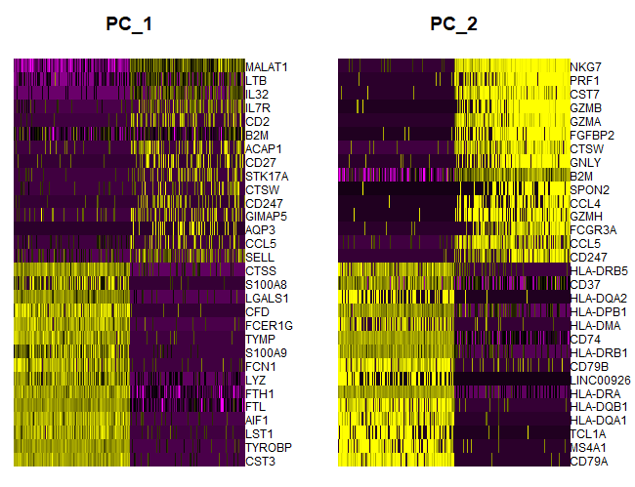
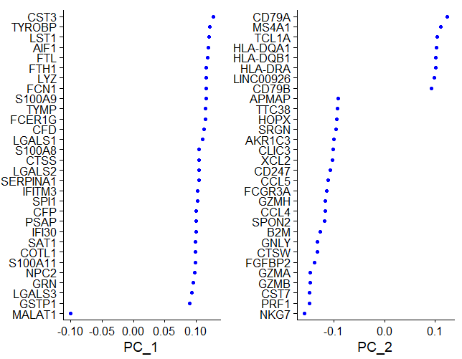
PCA Dim Loadings
anchor
Plot: PCA Loading x Gene
Plot: Cell X Gene, color is PC loading. Cells and genes sorted by PC score.
anchor
Notes:
https://www.dreamstime.com/stock-illustration-dna-vector-illustration-human-structure-image49975743

Slide 17
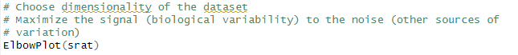
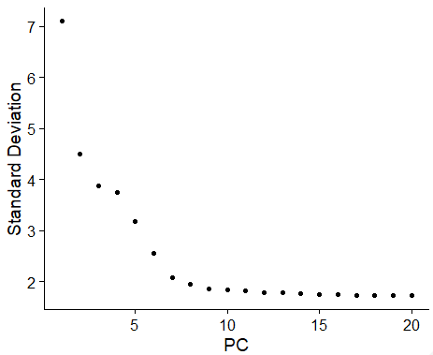
Linear Dimension Reduction
anchor
Select the range of principal component (PC) dimensions that capture the majority of variance.
For the nonlinear clustering (next steps), we wish to discard as many PCs as possible while still capturing the
variability in the data.
Elbow plots display variation captured by each PC, choose a point of diminishing returns for the threshold (dimensions 8-15 would be reasonable for this plot).
Too few PCs: key biological variability in the dataset is discarded.
Too many PCs: biological variation is masked by other sources of variation (signal to noise decreases from other sources of variation).
anchor
Notes:
https://www.dreamstime.com/stock-illustration-dna-vector-illustration-human-structure-image49975743

Slide 18
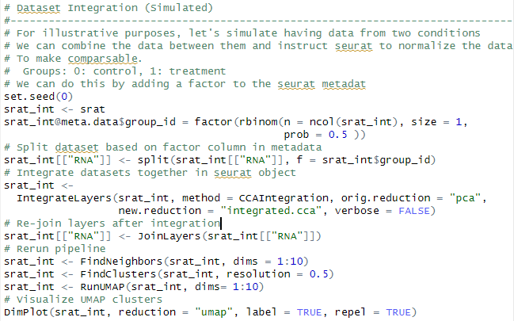
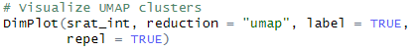
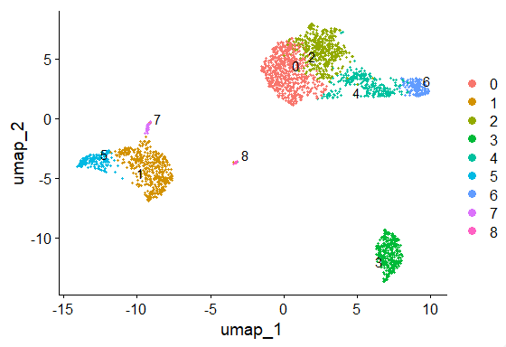
Integrating Datasets
Note: clustering and non-linear dimension reduction must be repeated after integration.
Often datasets need to combined across different batches, timepoints, or conditions (integration).
Seurat normalizes the data to make the data comparable between these groups.

Slide 19
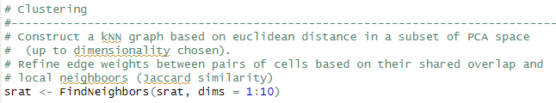
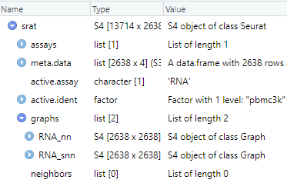
Identifying Neighboring Cells
anchor
Before clustering the data, we need to identify the nearest neighbors and score their
similarity in gene expression.
Two-tiered graph analysis:
kNN: k nearest neighbor graph
sNN: shared nearest neighbor graph (secondary graph based on kNN, performs better than kNN in high dimesionality)
anchor
Notes:
https://www.dreamstime.com/stock-illustration-dna-vector-illustration-human-structure-image49975743

Slide 20
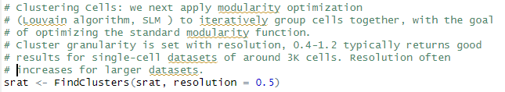
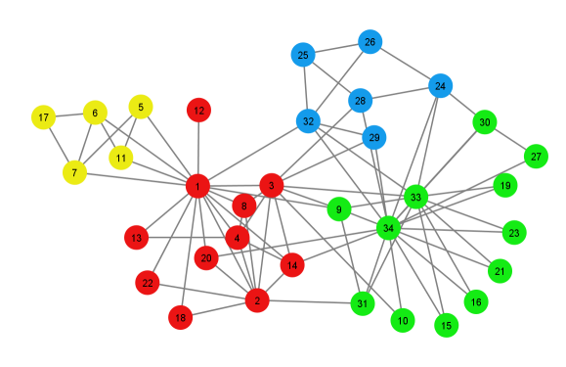
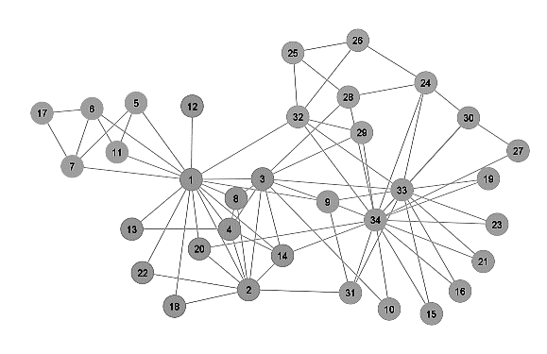
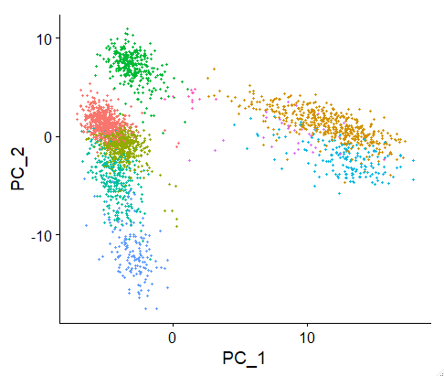
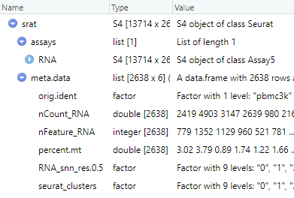
Use Neighbor Graphs to Identify Clusters
anchor
Use kNN and SNN graphs to identify clusters by optimizing a modularity function
Modularity
Function
anchor
Notes:
https://www.dreamstime.com/stock-illustration-dna-vector-illustration-human-structure-image49975743

Slide 21
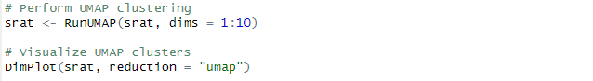

Nonlinear Dimension Reduction
anchor
Perform and visualize nonlinear dimension reduction of cluster with the Uniform Manifold Approximation and Projection (UMAP)
anchor
Notes:
https://www.dreamstime.com/stock-illustration-dna-vector-illustration-human-structure-image49975743

Slide 22










…But what is truth?

Slide 23








…But what is truth?

Slide 24




Why use not use tSNE?
anchor
tSNE scales poorly with execution time and memory consumption for rapidly increasing sample sizes in scRNAseq.
tSNE does not preserve global data structure.
tSNE can practically only embed into 2 or 3 dimensions, i.e. only for visualization purposes.
tSNE can not work with high-dimensional data directly, Autoencoder or PCA are often used for performing a pre-dimensionality reduction.
https://umap-learn.readthedocs.io/en/latest/benchmarking.html
Time (s)
Dataset size
https://towardsdatascience.com/how-exactly-umap-works-13e3040e1668
anchor

Slide 25
Limitation of Interpreting UMAP Clusters
anchor
Hyperparameter Sensitivity
Cluster assignment and global structure are highly sensitive to hyperparameter value. It’s best to run UMAP many times with a variety of hyper parameters.
2. Cluster sizes in a UMAP plot may mean nothing
Just as in t-SNE, the size of clusters relative to each other is essentially meaningless. This is because UMAP uses local distances to construct its high-dimensional graph representation.
3. Distances between clusters might not mean anything
While it's true that the global positions of clusters are better preserved in UMAP, the distances between them are not meaningful. Again, this is due to using local distances when constructing the graph.
4. Random noise doesn’t always look random.
Especially at low values of n_neighbors, spurious clustering can be observed.
5. You may need more than one plot
Since the UMAP algorithm is stochastic, different runs with the same hyperparameters can yield different results. Additionally, since the choice of hyperparameters is so important, it can be very useful to run the projection multiple times with various hyperparameters.
anchor

Slide 26





Other Features of Seurat
anchor
Analysis of imaging and sequenced based datasets
Integrating multimodal analysis
https://satijalab.org/seurat/articles/seurat5_spatial_vignette_2
https://satijalab.org/seurat/archive/v3.1/multimodal_vignette.html
anchor

Slide 27


scRNA-Seq pipelines are consistent across technologies & packages

Slide 28
Research Outputs from scRNA-Seq

Slide 29





Questions?
Bridging biological research and data science for the next generation of scientific discoveries.

